Slide 1


Harmonic Analysis and Distortion in HVDC Systems
Authors: Mohammed Aamir Imran
Affiliation: Power Grid Coorporation of India Limited
by MD AAMIR IMRAN

Slide 2

Motivation and Overview
Market Growth
Renewable Integration
Global HVDC market reached $8.7B in 2023, rising fast.
Vital for connecting remote renewables like offshore wind farms reaching 110 GW EU target by 2030.
Power Quality
Topics Covered
Harmonics threaten grid stability by causing losses and equipment faults.
Generation, impact, standards like IEEE 519, and mitigation strategies.

Slide 3
HVDC System Basics
LCC Converters
VSC Converters
Applications
Case Study
High power, cost effective. Example: Three Gorges-Changzhou ±800 kV, 7.2 GW.
Offers better control, smaller footprint. Example: INELFE France-Spain ±320 kV, 2 GW.
Grid interconnections
DolWin3 connects offshore wind to German grid, cutting losses by 60%.
Offshore wind integration
Back-to-back links

Slide 4

Harmonics and Distortion Metrics
Harmonics Defined
Frequency multiples of 60 Hz causing distortion in the waveform.
Non-Sinusoidal Waveforms
Produced by converter switching, leading to harmonic creation.
6-Pulse Converter
Generates 6n±1 harmonics such as 5th, 7th, 11th, 13th orders.
Total Harmonic Distortion (THD)
Harmonic voltage/current ratio to fundamental. Limits: 5% (voltage), 8% (current).

Slide 5




Harmonic Generation in HVDC
LCC Sources
VSC Sources
Harmonics arise mainly from AC/DC switching actions.
1
2
Harmonics linked to PWM switching above 2 kHz frequency.
Harmonic Spectra
Filtering Needs
4
3
12-pulse LCC and MMC-HVDC systems show differing harmonic patterns.
LCC requires more extensive filters than VSC due to harmonic profiles.

Slide 6
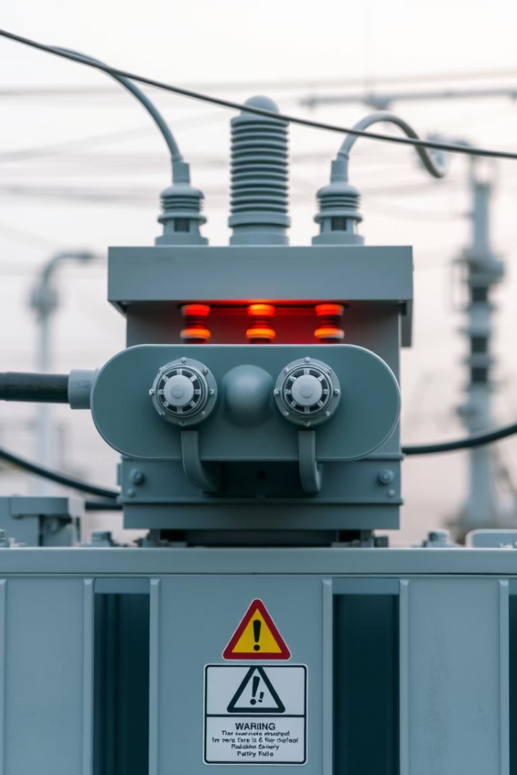




Impact of Harmonics on Grid
Equipment Overheating
Resonance Risks
Protection Malfunction
Harmonics amplify at specific frequencies causing instability.
Transformers and motors suffer thermal stress from harmonics.
False relay trips and misoperation due to distorted signals.
Communication Noise
Power line communication suffers interference from harmonics.
Capacitor bank failures increase by 20% due to harmonic stress.

Slide 7





Harmonic Standards and Mitigation
IEEE 519 Limits
Passive Filters
Active Filters
STATCOM Solution
Defines maximum voltage/current distortion at point of common coupling.
Simple LC filters tuned to common harmonics like 5th and 7th.
Adaptive compensation yielding up to 98% harmonic reduction.
Used in HVDC-VSC for dynamic harmonic mitigation and voltage support.

Slide 8

Summary and Conclusion
Importance
HVDC is vital but introduces harmonic challenges in grids.
Analysis Need
Accurate harmonic study ensures grid stability and equipment safety.
Mitigation
Standards compliance achieved via filters and active compensation.
Future Trends
Wide-bandgap devices improve quality and reduce filter sizes by 40%.

